Slide 1
WALMART RECRUITING : TRIP TYPE CLASSIFICATION
BY-HIMANSHI RANA
2017499

Slide 2
PRESENTATION OUTLINE
INTRODUCTION
STATEMENT PROBLEM
TOOLS AND SOFTWARE USED
METHODOLOGY
DIFFICULTIES FACED
FURTHER IMPROVEMENT
LIMITATIONS
FUTURE PLAN

Slide 3

INTRODUCTION
Walmart is an American multinational company that operates a chain of hypermarkets, discount department stores and grocery stores from the United States.
Faced with the competition from e-commerce platforms, traditional retailing enterprises have introduced cutting-edge technologies such as Machine Learning, the Internet of Things, and Artificial Intelligence to optimize offline scenarios. Walmart is at the frontier and is currently taking advantages of approaches, including behavioural approaches, psychographic approaches, demographic approaches, and geographic approaches in target market selection and market segmentation.
The purpose of this project is to help Walmart better segment customers to personalize the service and advertising. Based on the items purchased by customers, Walmart has categorized trips into 38 types and expects data experts and enthusiasts to recreate the classification with fewer features. We are excited to confront the challenge.

Slide 4
STATEMENT PROBLEM
Walmart Recruiting Trip Type Classification is a project in which we manage data of pre loved goods by the customers collected by Walmart in different states and processing the data and getting the most favorable outcome helping the customer purchasing experience by using decision tree classification.

Slide 5
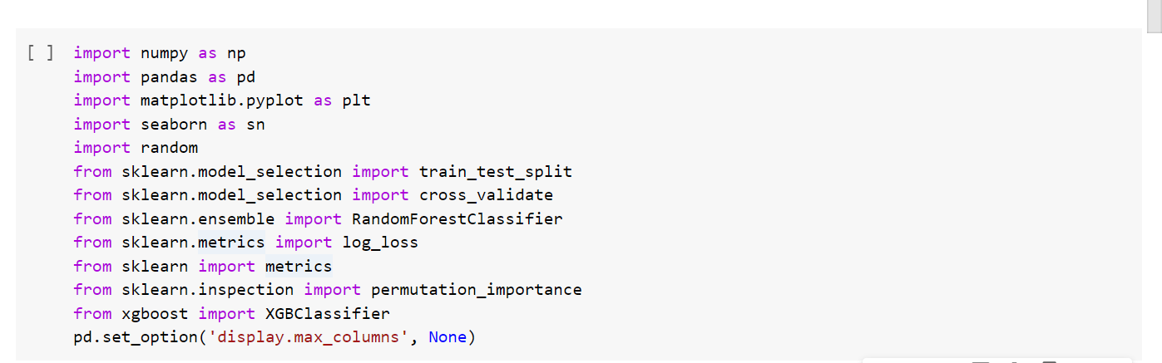
TOOLS AND SOFTWARE
SOFTWARE USED-
GOOGLE COLAB
LIBRARIES USED

Slide 6
METHODOLOGY
RANDOM FOREST CLASSIFIER- A random forest is a meta estimator that fits a number of decision tree classifiers on various sub-samples of the dataset and uses averaging to improve the predictive accuracy and control over-fitting. It uses multiple decision trees .
XGBOOST CLASSIFIER- XGBoost is a decision-tree-based ensemble Machine Learning algorithm that uses a gradient boosting framework.The algorithm differentiates itself in the following ways: A wide range of applications: Can be used to solve regression, classification, ranking, and user-defined prediction problems.

Slide 7
DIFFICULTIES FACED
Each observation represents a specific item instead of all the purchasing items on a trip
Multi-class Imbalance
Non-descriptive data

Slide 8
FURTHER IMPROVEMENT
Feature Engineering
(2) Collect More Data
Walmart only provides us with purchase records of customers. If more information like demographic data is provided, the models will achieve a higher accuracy.

Slide 9
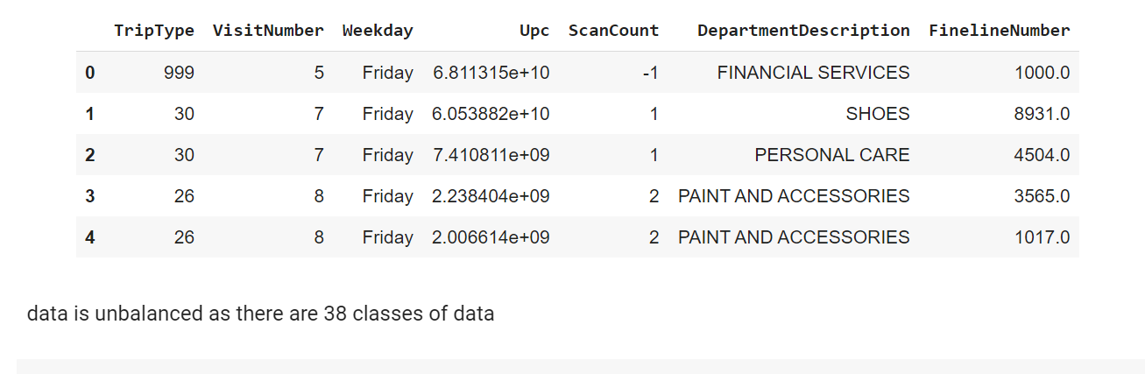
LIMITATIONS
Walmart only provides us with purchase records of customers. If more information like demographic data is provided, the models will achieve a higher accuracy.

Slide 10
FUTURE PLAN
To reduce the log loss , so as to receive more accuracy.
To add more graphs and charts .

